Slide 1
Tax Treaty provisions for NRI’s and OCI’s

Slide 2
Agenda
Definition – NRI / OCI
Scope of taxation
Income
Salary
Independent personal services
Director’s fees
Pension and social security
Other income
Interest from NRE accounts

Slide 3
Non-Resident of India and Overseas Citizen of India

Slide 4
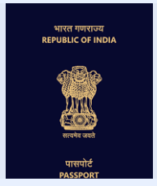
Definitions
Non-Resident of India (NRI)
Indian citizen
Works / resides outside India
Intends to stay out of India for an indefinite period
Overseas Citizen of India (OCI)
Person of Indian origin, foreign citizen
Holds a foreign passport
Registers as OCI under the Citizenship Act of India
Eligible for special privileges such as lifelong visa for stay in India

Slide 5
Residential Status - individuals

Slide 6
Basic conditions
Physical presence
182 days or more; or
60* days or more and 365 days or more in preceding four years
Yes
No
Resident
Non-Resident
Has been a non-resident in 9 out of 10 preceding years; or
Has been in India for 729 days or less during 7 preceding years
*Explanation 1 –
In case a citizen of India leaves India for the purpose of employment outside India, 60 days shall be substituted with 182 days.
2) Similarly, in case of a citizen of India or person of Indian origin having total income (excluding foreign sourced income) exceeding INR 15 lakhs, 60 days shall be substituted with 120 days.
No
Yes
Resident and ordinarily
resident
Resident but not ordinarily resident

Slide 7
Resident but not ordinarily resident

Slide 8
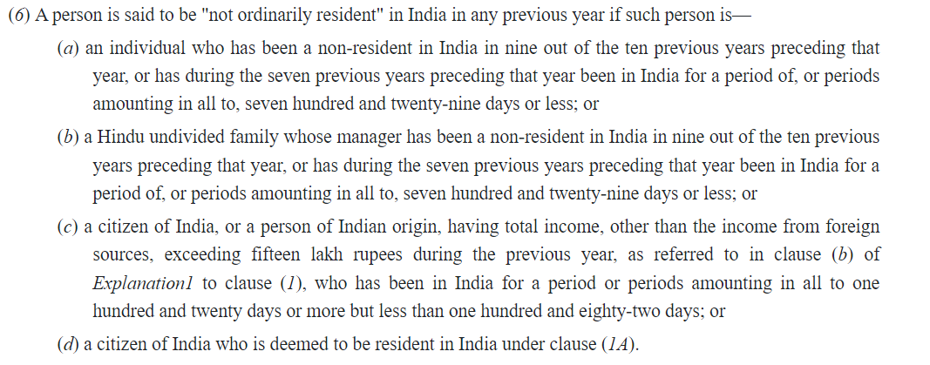
Resident but not ordinarily resident

Slide 9
Deemed to be a resident in India

Slide 10
Deemed resident
Citizen of India?
Yes
No
Liable to tax in any other country by reason of domicile or residence or any other criteria of similar nature?
Yes
Apply regular provisions to determine residential status
No
Having total income (excluding income from foreign sources) exceeding INR 15 Lakhs?
No
Yes
Deemed to be Resident but not ordinarily resident

Slide 11
Case study -1
What is the residential status
D is a citizen of USA and an OCI
Stay in India
– 130 days in FY 23-24 &
– less than 300 days in the previous 4 years
Derives incomes in India totaling INR 8,00,000 during FY 23-24

Slide 12
Case study -2
What is the residential status
Ms. X is an OCI, tax resident of Singapore
Stay in India – 160 days in FY 23-24
Derives income in India totaling to INR 20,00,000 during FY 23-24
Tax liability in Singapore: NIL

Slide 13
Scope of taxation

Slide 14
Section 9
9(1)(i) – Income from business connection, property, asset, source of income, transfer of capital asset situated in India
9(1)(ii) / (iii) – Salaries
9(1)(iv)- Dividend paid by an Indian company outside India
9(1)(v) - Interest
9(1)(vi) / (vii) – Royalties/ Fees for technical services
9(1)(viii) – Gift by a resident to a non-resident

Slide 15
Salary

Slide 16
The Income-tax Act, 1961

Slide 17
Article 15 – Dependent personal services
Subject to the provisions of Articles 16, 18 and 19
Salaries, wages and other similar remuneration DERIVED
by a resident of a Contracting State in respect of an employment
shall be taxable only in that State unless the employment is exercised in the other Contracting State
If the employment is so exercised, such remuneration as is derived
therefrom may be taxed in that other State
Specific Articles will prevail
Means time or place of payment of salary is not relevant
Exercise means the place where an employee is physically present while performing the services

Slide 18
Exception
Under the Act – Section 10(6) (vi)
Under the treaty – Paragraph 2
Applies to a foreign national (+)
Employed with a foreign employer (+)
Foreign employer not engaged in a trade or business in India (+)
Stay in India does not exceed 90 days in the relevant year (+)
Remuneration is not liable to be deducted from the income of the foreign employer chargeable to tax in India.
Presence in source country is within 183 days (+)
The salary is paid by or on behalf of an employer who is not a resident of source country (+)
The salary is not borne by a permanent establishment or a fixed base or a trade or business which the employer has in the source country

Slide 19
Case study -1
Employed outside India
Mr. H, citizen of India
Moves to Japan for a period of 2 years for employment
Receives a portion of the salary in Japan and the balance in India
Non-resident in India as his physical presence is less than 60 days
Tax resident of Japan
Whether the salary he receives in India is taxable ?
Q

Slide 20
Case study -2
OCI working from India for a temporary period
Ms. R is a US citizen, and a tax resident employed by XYZ Inc.
She receives her salary fully outside India.
Stays in India for 2 months to take care of his parents.
Works from her home in India.
Whether the salary she receives in the US is taxable ?
Q

Slide 21
Independent Personal Services

Slide 22
The Income-tax Act, 1961
The consideration received by a non-resident would qualify as fees for technical services.
The scope of Section 9(1)(vii) is wide enough to cover managerial, technical or consultancy services.

Slide 23
Article 14
OECD Model Convention – Article was deleted in the 2000 version
UN Model Convention – Article 14
Exists in the treaties entered by India
Taxable in the country where the individual / firm is a resident
May also be taxable in the other country if the individual
stays for a specific period and
has a fixed base in other country
Q
What if this Article is not present in the treaty ?

Slide 24
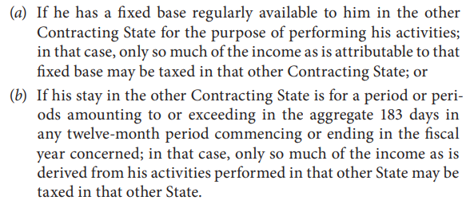
Article 14

Slide 25
Coverage
Fields: inclusive definition
Independent scientific, literary, artistic, educational or teaching activities
independent activities of physicians, lawyers, engineers, architects, surgeons, dentists and accountants
Other services of independent character
Excludes
Professional services performed in employment (dependent personal services)
Industrial and commercial activities

Slide 26
Analysis
Mr. J is a British national, architect by profession
Tax resident of Singapore
Provides services as an architect in his individual capacity of an independent professional to a company (A Limited) in India
Stays in India for less than 60 days
Has no fixed base in India
Extracts of the treaty

Slide 27
Extracts of India-Singapore treaty

Slide 28
Director’s Fees

Slide 29
Remuneration
Paid for services or employment of directors on the Board
Regulated by Companies Act, 2013
Employee
Technical services
Member of the Board
Regular payments
Salary
Sitting fees
Retainer fees
Commission
Q

Slide 30
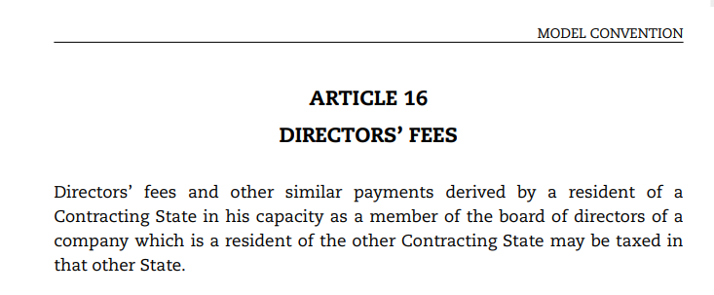
Article 16
Q
What if the director never visits India ?

Slide 31
Analysis
Ms. Z – resident of the USA during FY 24-25
Director of the Board of ABC Limited (resident of India)
Receives INR 10,00,000 from ABC Limited as Director’s Fees during FY 24-25
Taxability in India
ABC Limited is a resident of India
Director’s Fees paid by ABC Limited is taxable in India
Ms. Z being a tax resident of the USA has no significance here
Taxability in the USA
Ms. Z needs to report the income in the USA
Ms. Z may be eligible for a tax credit in the USA

Slide 32
Case Law
AAR in Dieter Eberhard Gustav Von Der Mark V. Commissioner of Income-tax 235 ITR 698 (AAR)
Facts
Applicant was a citizen and resident of Germany, tax non-resident of India
Consultancy agreement with Pennwalt India Limited (“PIL”) (resident of India)
Appointed as a non-whole-time non-resident additional director of PIL
Applicant to receive consultancy fees, commission, sitting fees and reimbursement of travelling and other expenses
Questions
Whether fee is taxable under Article 14 (Independent Personal Services)?

Slide 33
Judgement
Sitting fees for Board Meetings
subject to Article 16 (Director’s fees)
Article 16 – fixed base not necessary for taxation in that country
Taxable in India
TDS is applicable
Consultancy fees:
subject to Article 14 (Independent Personal Services)
Not taxable in India
Notes:
Income accruing or arising in India – income from property situated in India, income from transfer of capital asset in India
Income deemed to accrue or arise in India - salaries earned in India (even if it is received outside India)
- Salary paid by the Government to a citizen for services rendered outside India (Indian nationals working in Indian embassies and consulates or similar diplomatic missions outside India).
- interest, royalties or fees for technical services paid by the Government are also deemed to accrue or arise in India.
- Dividend paid by an Indian company outside India

Slide 34
Pension and Social Security

Slide 35
Definition
Article 18 of the OECD Commentary
Social security legislation definition:
Mandatory protection by the State
Retirement benefit
Retirement pensions available to the general public under a public pension scheme or old age pension payments.

Slide 36
Provident Fund
Employees’ Provident Fund and Employees’ Pension Scheme:
Mandatory protection provided by the Central legislation
Purpose is to provide for retirement benefit
Old age pension payments
India has bilateral social security agreement with various countries, considering Provident Fund as social security legislation of India.
Provident Fund would be covered under the definition in Article 18 of the OECD Commentary

Slide 37
Income-tax Act
Periodic payments
Monthly pension from Employees’ Pension Scheme – taxable as salary
Lumpsum payment
Withdrawal of accumulated balance in Provident Fund – taxable (subject to conditions)

Slide 38
Income-tax Act – Section 89A
Allows for taxation of foreign social security in India in the year of redemption / withdrawal (as against on accrual basis)
Effective from assessment year 2022-23
Applicable only to notified countries:
Canada
UK
USA
Form 10EE to be filed within due date for filing tax return

Slide 39
Section 89A
Proceeds from withdrawal / redemption which are taxable in India not to include:
Amounts already taxed in India (for example – any amount already taxed on accrual basis prior to Section 89A coming into force)
Amounts not taxable in India owing to
India tax non-resident status of the individual or
Application of tax treaty benefits

Slide 40
Tax treaty
Articles 18 / 19 /20 in most treaties
Pensions:
Taxable in the country in which they arise
Deemed to arise in that country in paid by the Government / political sub-division or a local authority or a resident of that country
Some treaties cover only periodic payments under Article on Pensions
Any other pension payments (such as lumpsum payments) would be covered under Articles dealing with Dependent Personal Services or Other Income

Slide 41
Case study
Mr. Q works for DEF Limited (Indian Co.) in November 2023 at the age of 60 years
Moves permanently to UK in November 2023
Contributions made to PF from November 2019 to November 2023
Lumpsum payment (withdrawal of PF balance) is received by Mr. Q
Based on Article 20 of the India-UK DTAA, Pension
Taxable only in the country in which the recipient is a resident
Includes “any payments made under the social security legislation of either Contracting State”

Slide 42
Case study
Scenario 1
Lumpsum payment (withdrawal of PF balance) made to Mr. Q in May 2024
Mr. Q qualifies as a non-resident in India and resident of UK for FY 24-25.
Scenario 2
Lumpsum payment (withdrawal of PF balance) made to Mr. Q in March 2024
Mr. Q qualifies as RNOR in India and UK non-resident for FY 23-24.

Slide 43
Other income

Slide 44
Tax treaties
All tax treaties (except for Libya, Greece and the Netherlands) have “Other Income” Article
Terminology could differ, depending on the treaty:
‘items of income not dealt with’ ,
‘items of income not expressly dealt with ’ and
‘items of income not expressly mentioned
3 clauses in the UN model
Taxable only in the recipient’s country of residence
Exceptions
Right to tax of source country

Slide 45
India’s tax treaties
Resident country
India UAE DTAA
Source country
India US DTAA
India Singapore DTAA
As per domestic laws

Slide 46
Case study
An Indian resident is receiving pension from his deceased spouse’s UK employer
Taxes were deducted on the said pension payment in UK
Q
Is this pension taxable in India ?
Taxable under pension or other income ?

Slide 47
Credits in NRE account

Slide 48
Overview
Eligibility to have NRE account is determined based on Foreign Exchange Management Act
Eligibility: Non-Resident Indians (NRIs), Persons of Indian Origin (PIOs), and Overseas Citizens of India (OCIs)
Purpose: to deposit foreign currency and use it to manage expenses and investments in India
Accounts to be redesignated to Resident account upon permanent repatriation to India.

Slide 49
Section 10(4)(ii)
Interest from NRE accounts are exempt from tax for a non-resident.
Interest from NRO accounts are taxable as there is no specific exemption.

Slide 50
Gifts

Slide 51
Gift received outside India
Gifts received by a non-resident
outside India
from a resident was
claimed to be non-taxable in India as
the income does not accrue or arise in India

Slide 52
Payments without consideration

Slide 53
Obligation
TDS under Section 195 to a resident gifting money to a non-resident
Resident to obtain TAN and file eTDS return
Non-resident to apply “Other income” Article under the DTAA & beneficial provisions will apply

Slide 54
Thank you
Lakshmi Pichaimani
Executive Director
Deloitte Touche Tohmatsu India LLP
lakshmip@deloitte.com
+91 91766 99379

